Slide 1

Second Review - Group B
Vernon Koo | Yi Jun Lau | Veronica Talucod | Phoebe Tsai | Xin Yu Wang | Josmin Thadathil | Luqmanul Awallizam

Slide 2
Team B - Roles
Team Managers
Technical Heads
Leader: Veronica
Co-Leader: Yi Jun
Secretary: Josmin
Treasurer: Vernon
Power Supply Unit:
Smart Meter Housing:
Interface Electronics:
Control Software and Display:

Slide 3
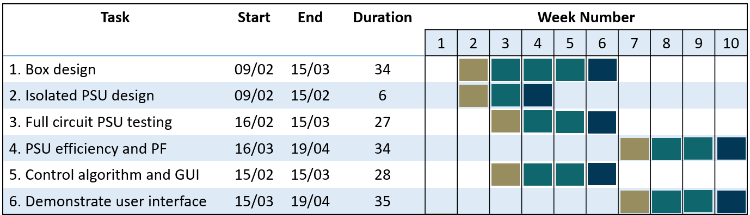
Gantt Chart
*Timeline from 8th February until 20th April = 71 days

Slide 4

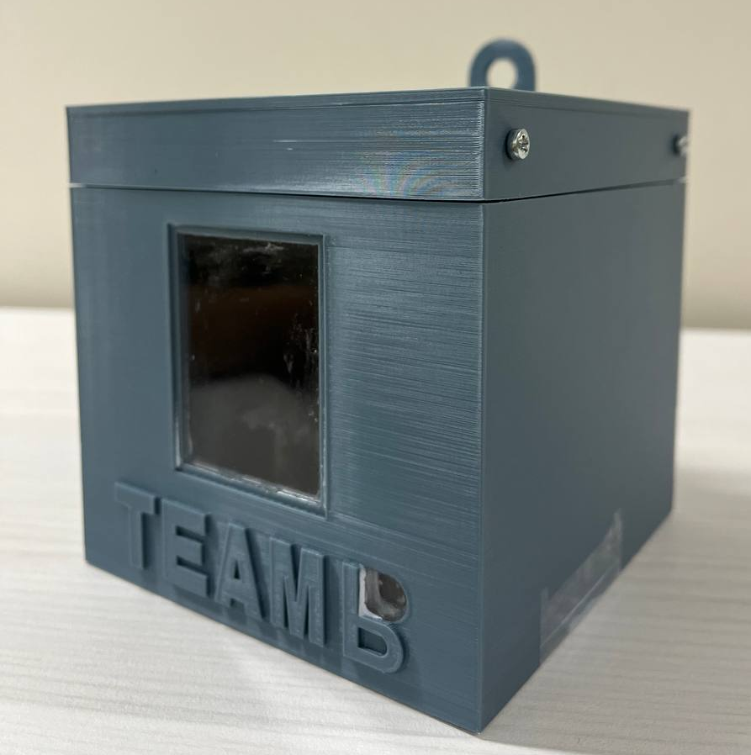
Smart Meter Housing

Slide 5
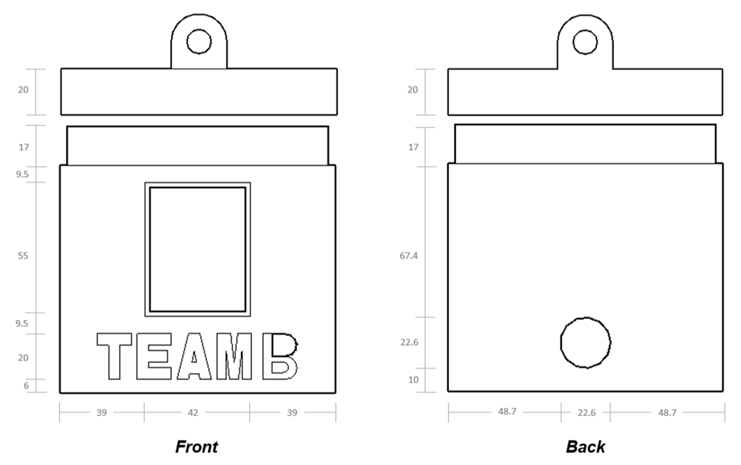
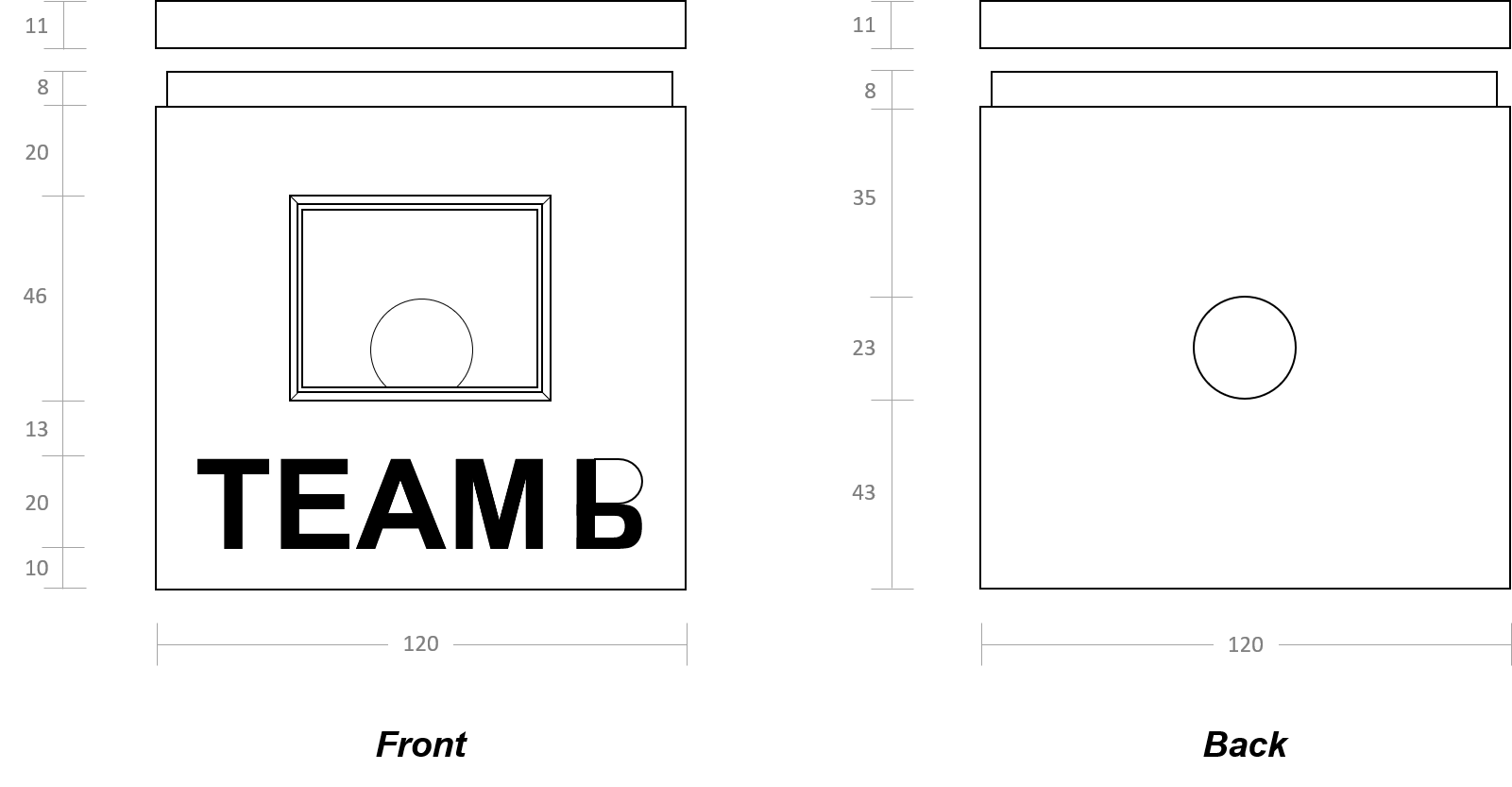
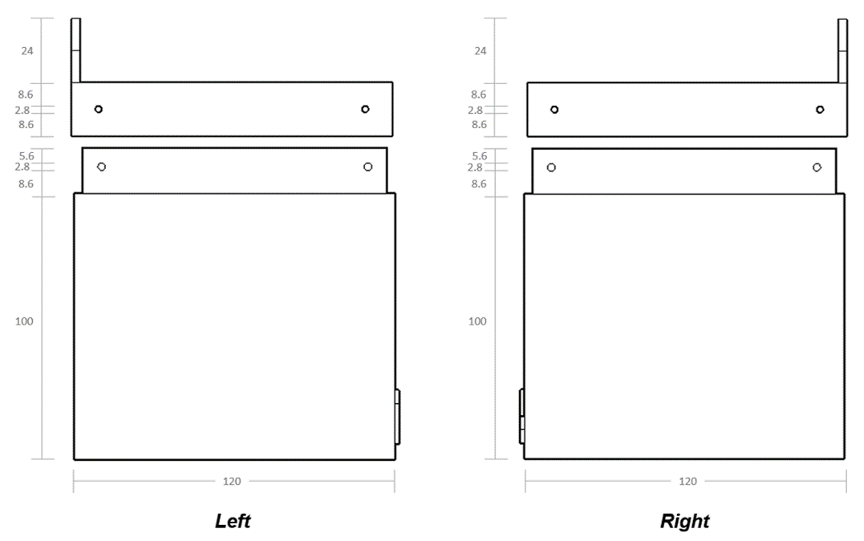
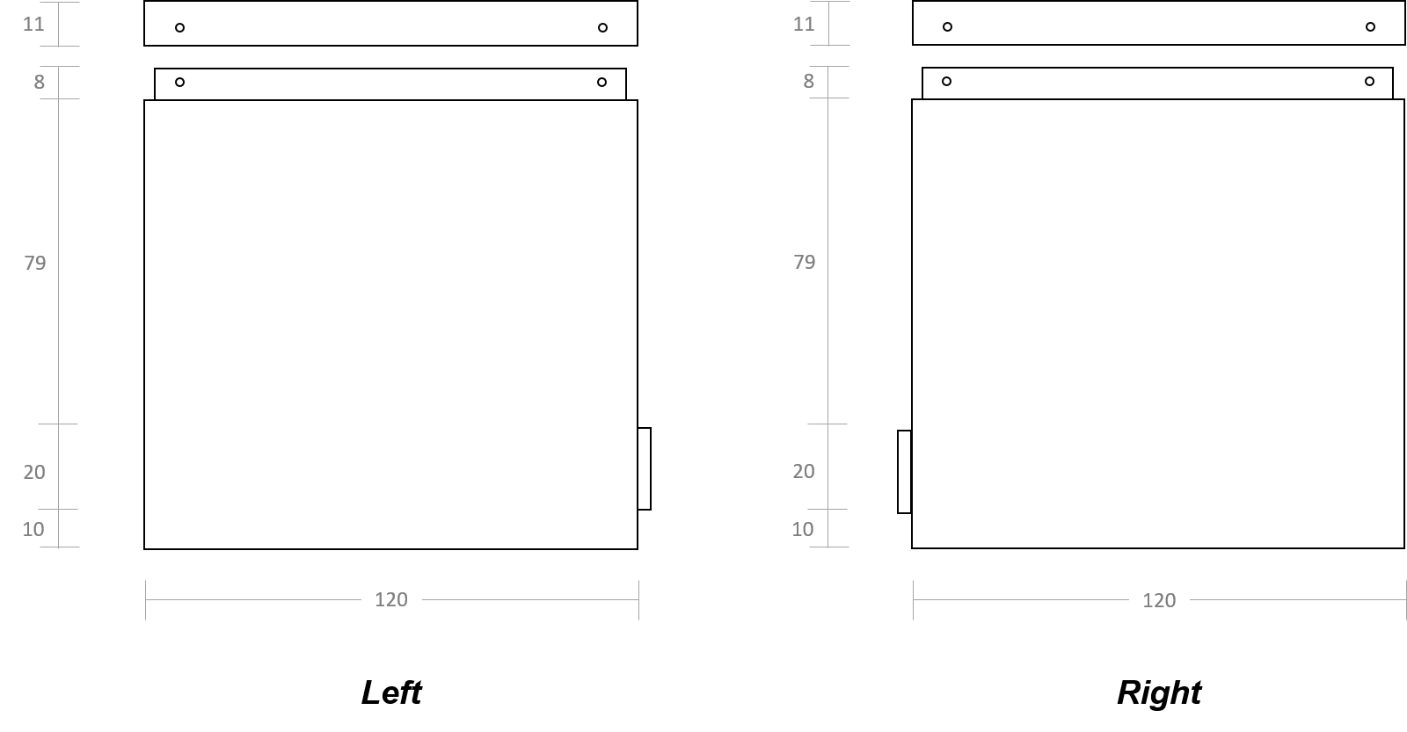
Initial Design
Final Design
Changes
LCD Opening
→ portrait orientation
→ laser-cut acrylic
Power Plug Hole
→ d = 22.6mm
→ lower placement
Raised Inner Wall
→ h = 17mm
Screw Holes
→ d = 2.8mm

Slide 6
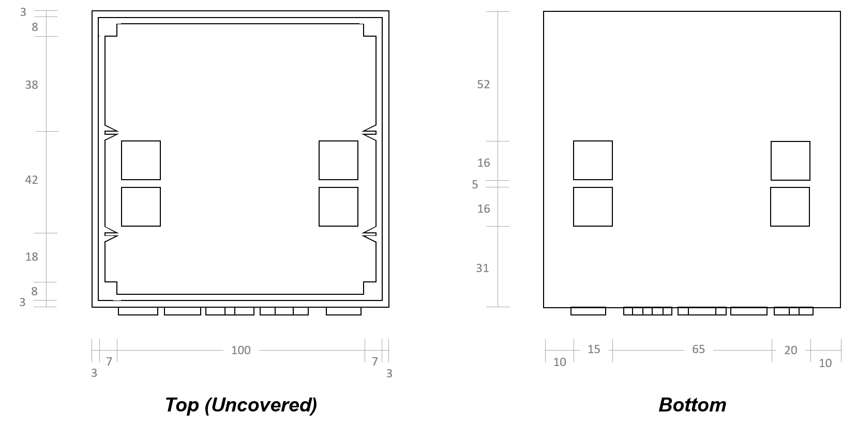
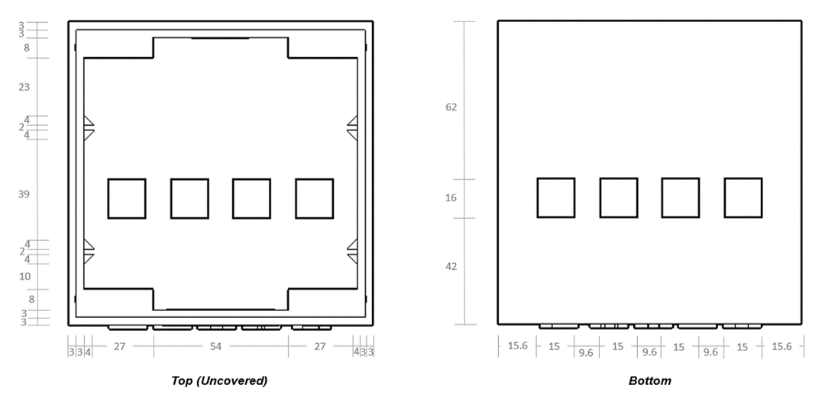
Initial Design
Final Design
Changes
RJ45 Sockets
→ altered placement
Inner Wall Extension
→ lengthened to fit M30 20mm screws
Triangular Knobs
→ adjusted area designated for each segment

Slide 7
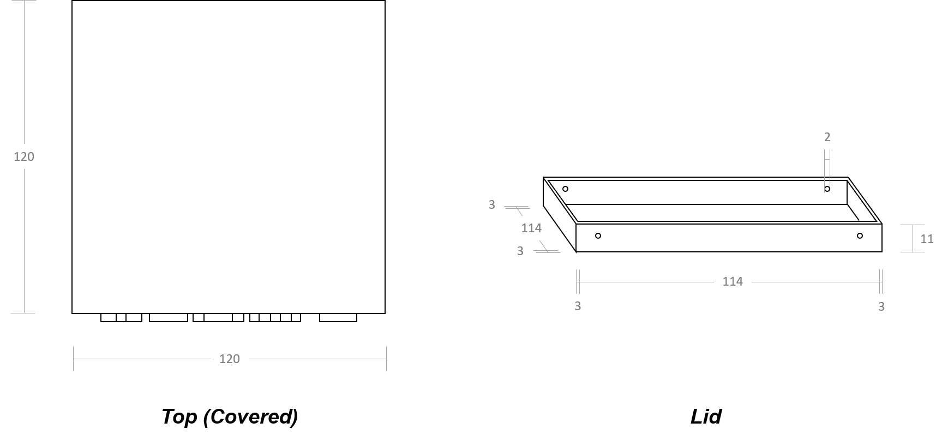
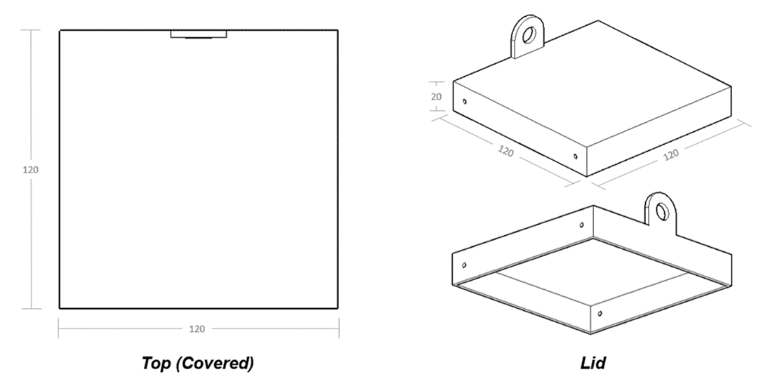
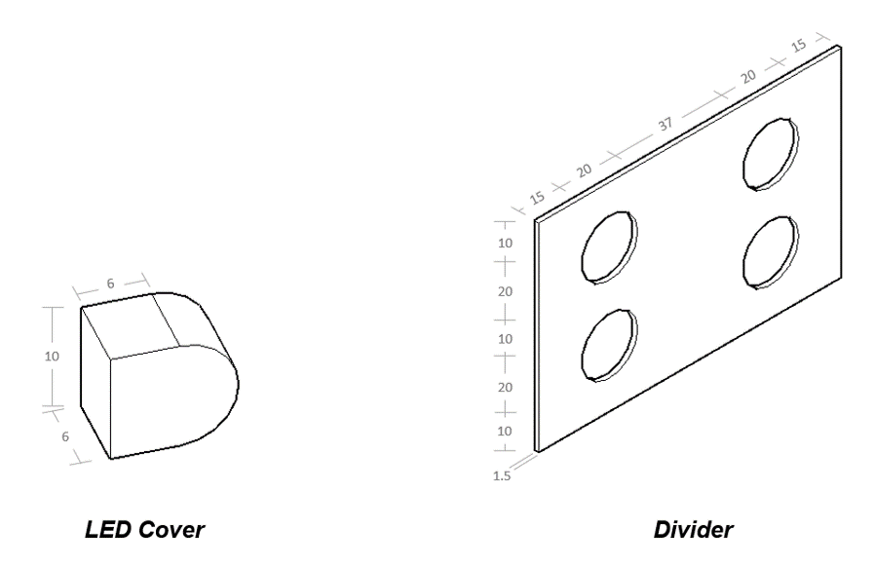
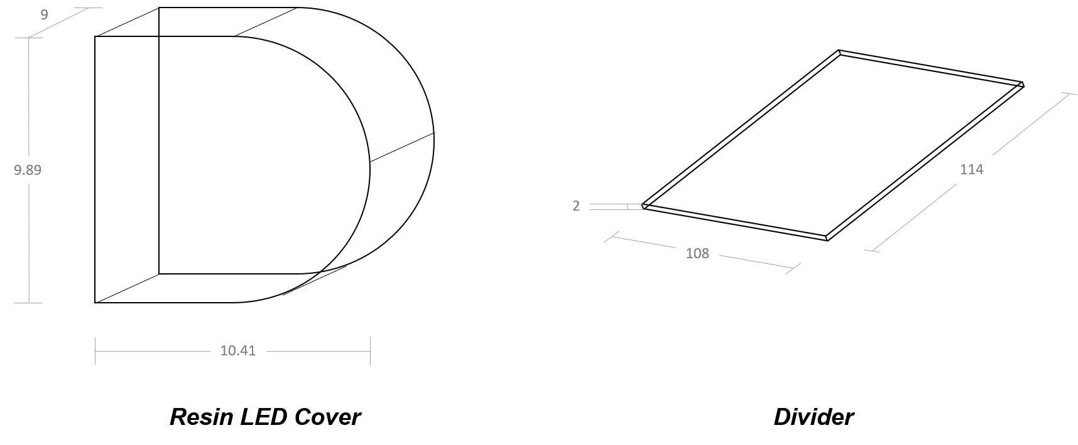
Initial Design
Final Design
Changes
Lid
→ h = 20mm
→ mounting lug attached
LED Cover
→ laser-cut acrylic
Divider
→ 4 20mm diameter holes

Slide 8
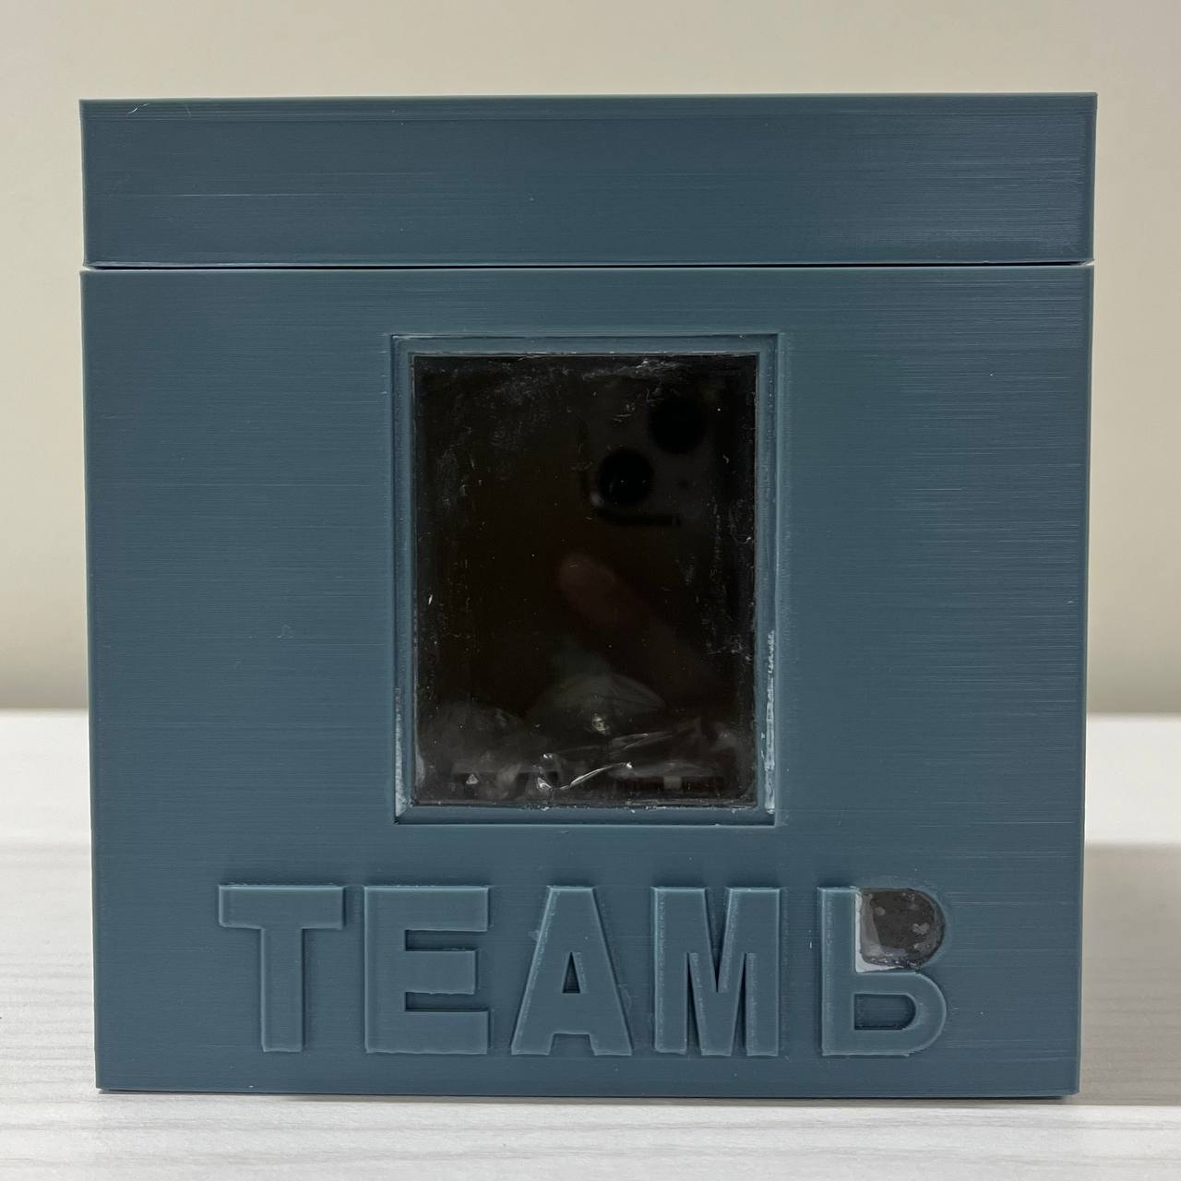
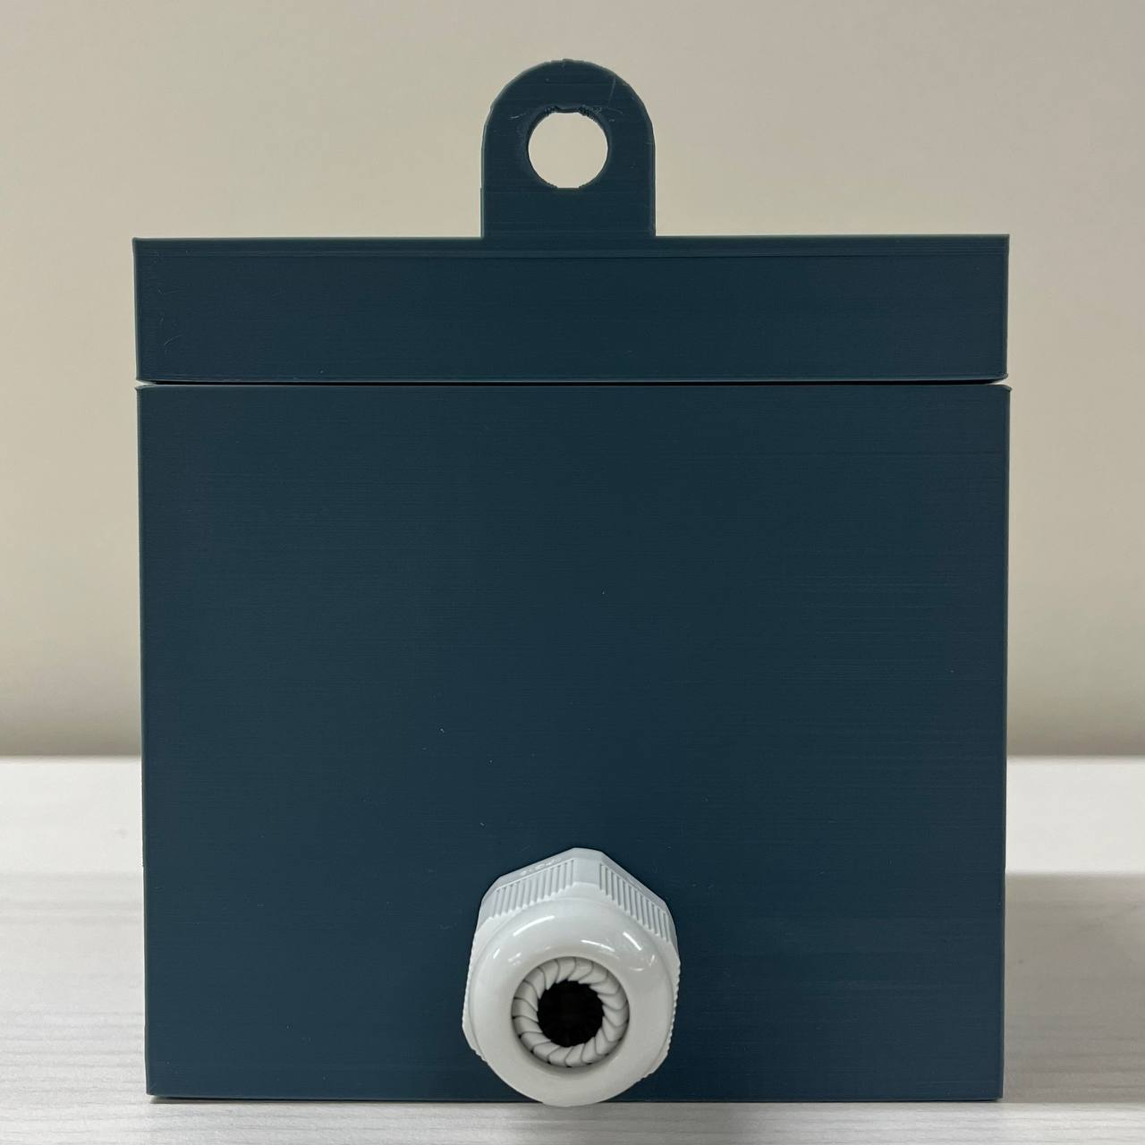
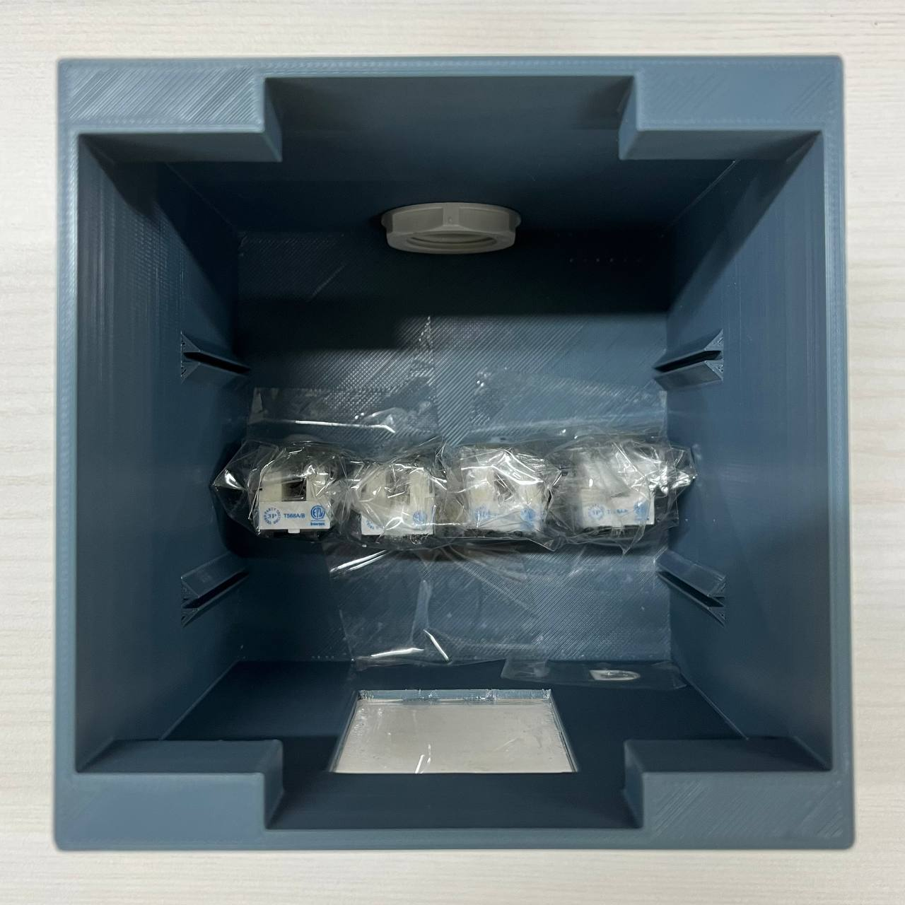
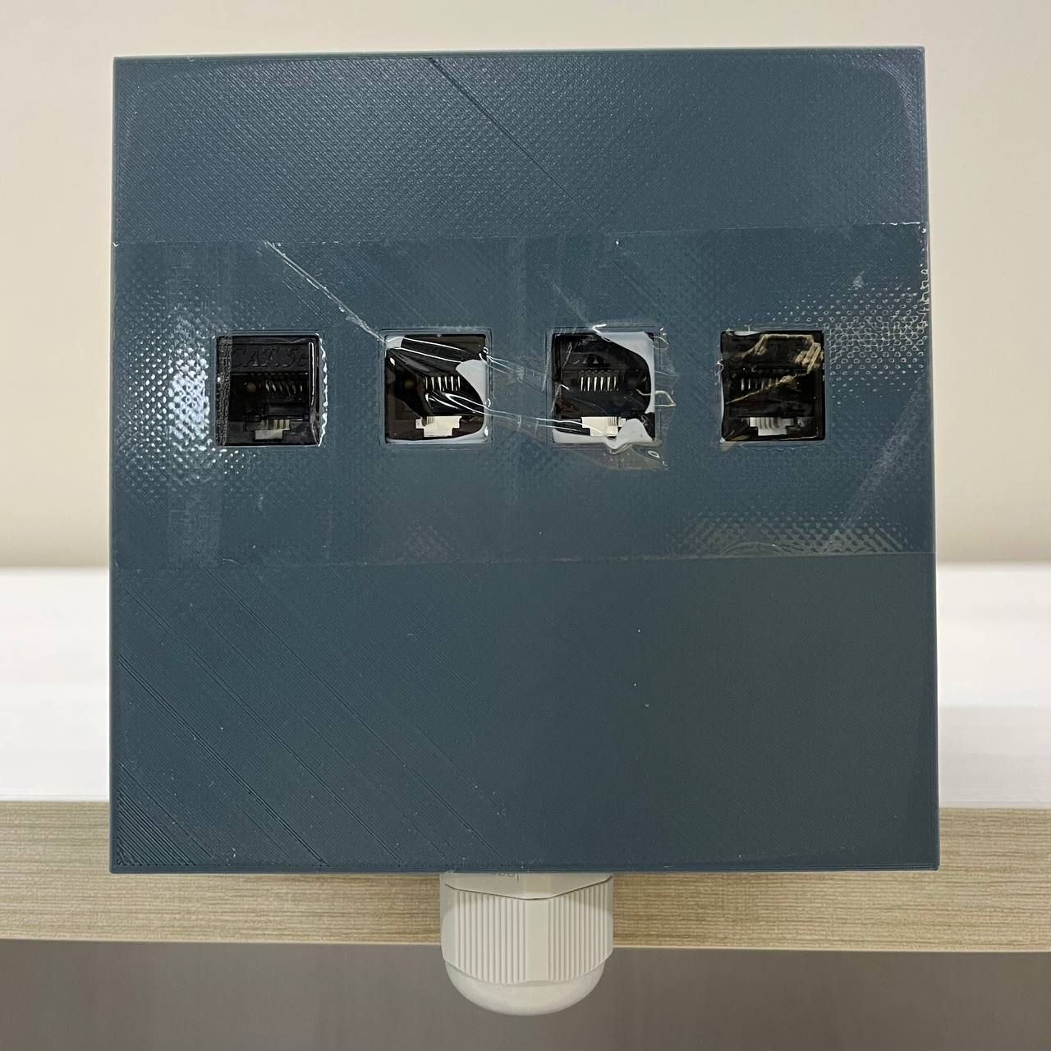
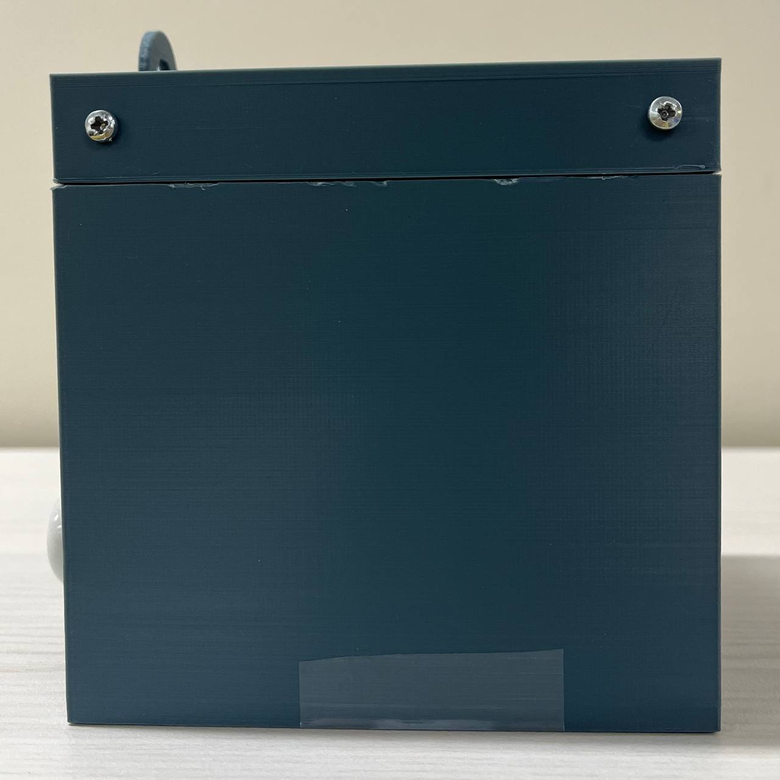
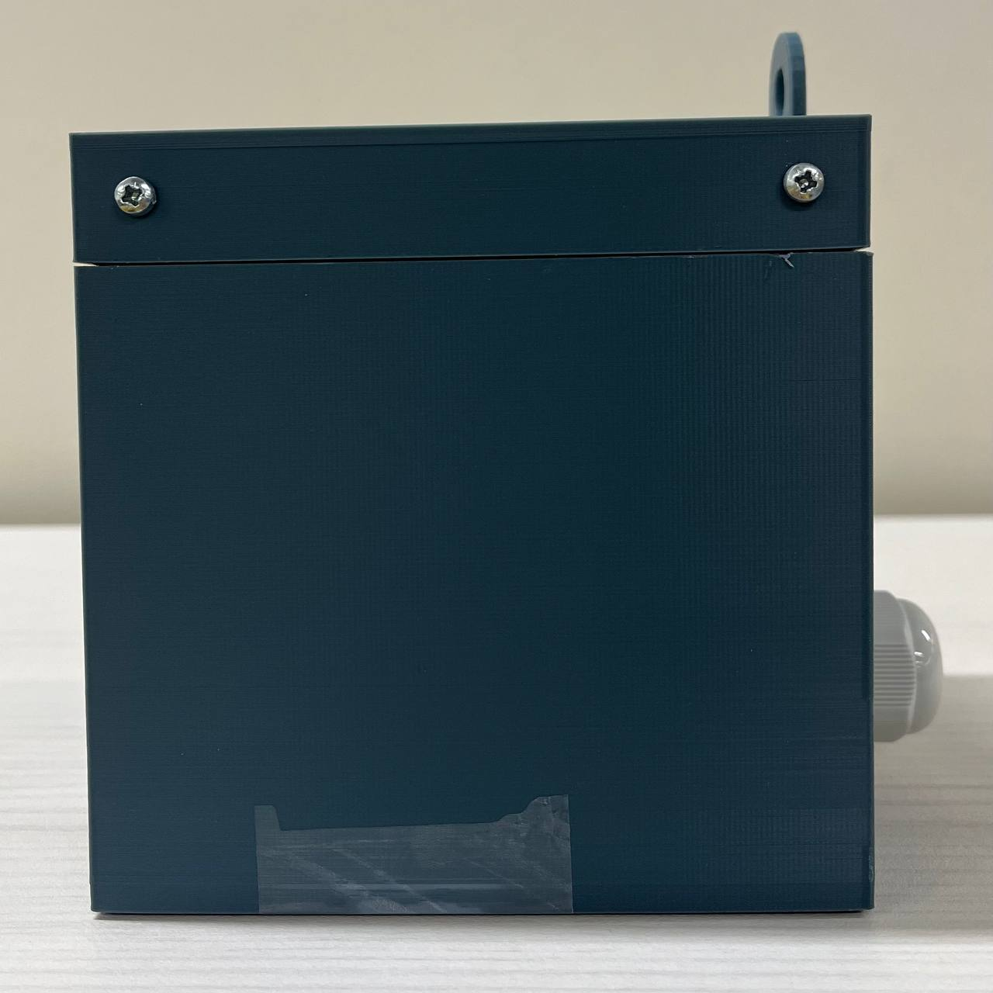
Smart Meter Housing

Slide 9
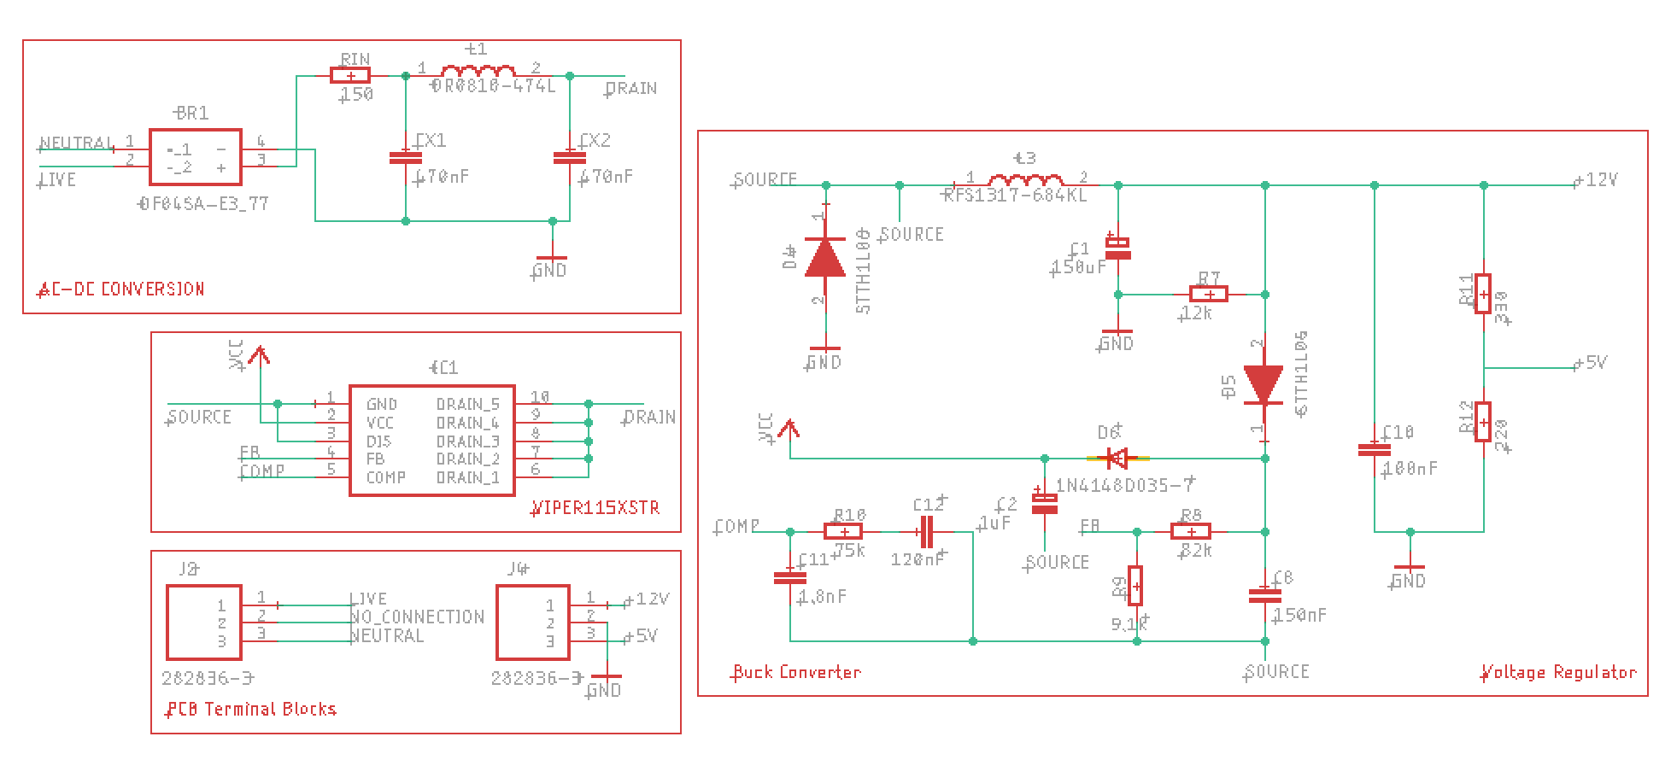
Power Supply1 -> IC-Based SMPS

Slide 10
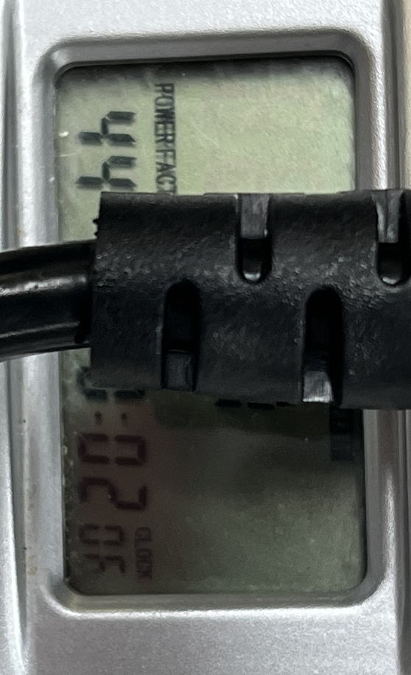
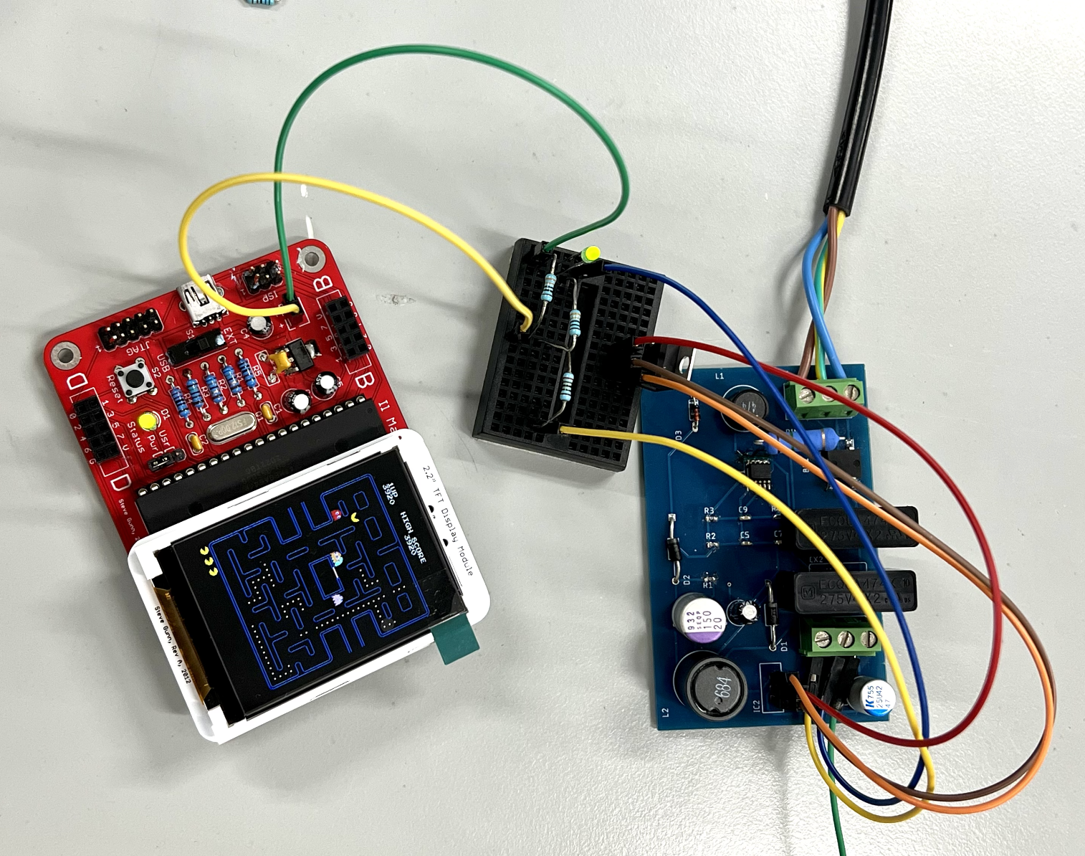
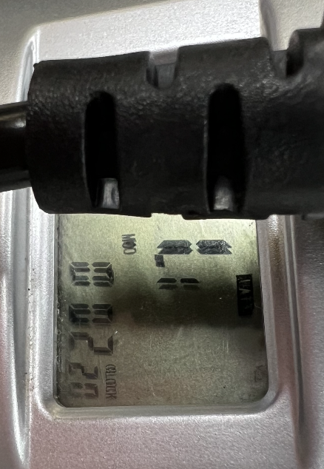
Power Consumption: 1.1W; Power Factor: 44

Slide 11
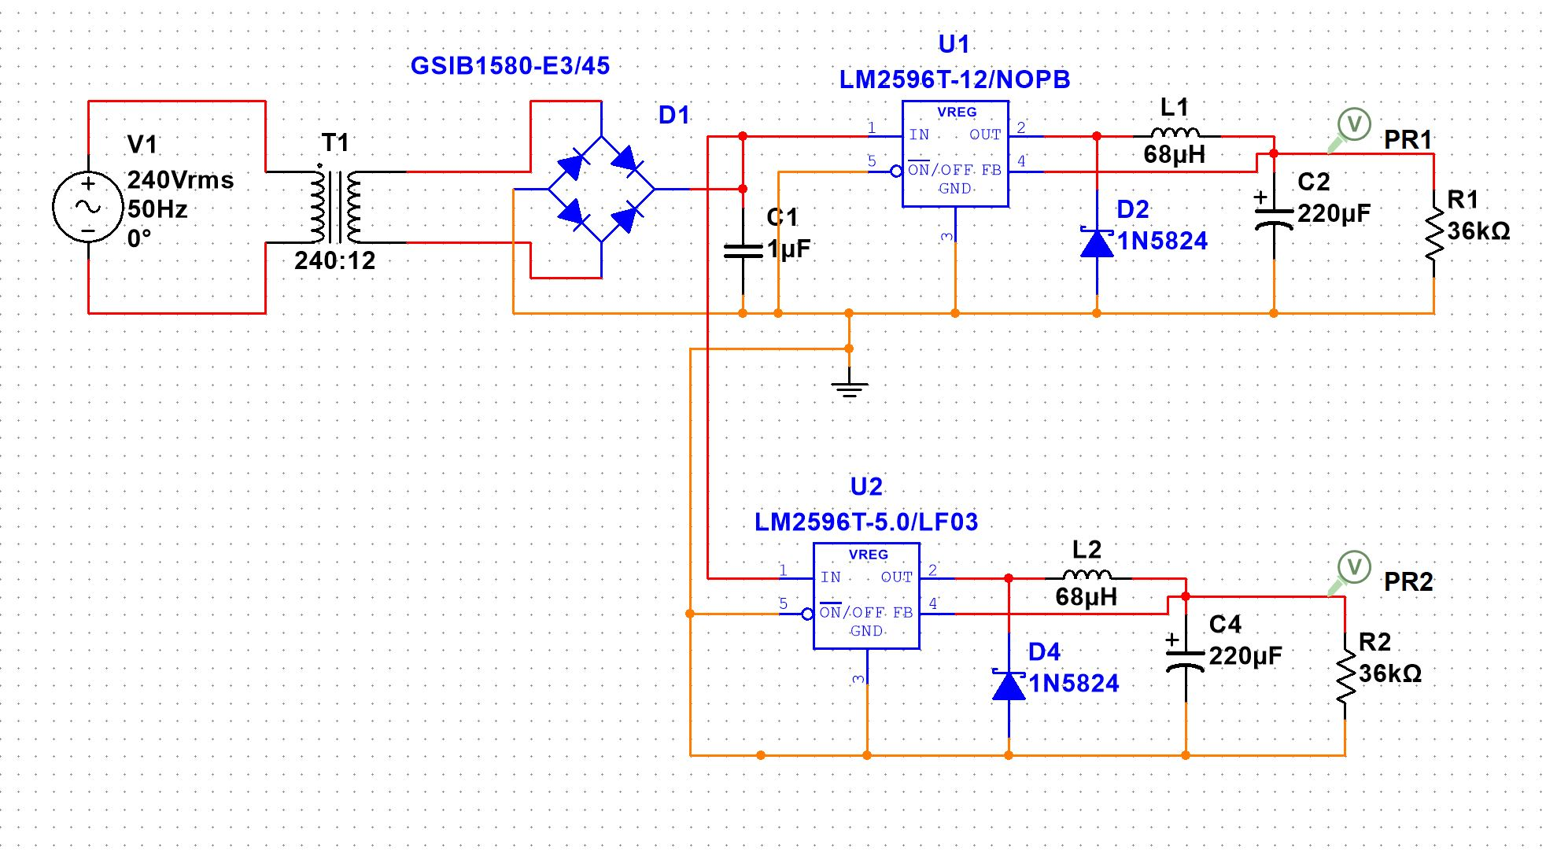
Power Supply2 -> Transformer with Switching Regulator

Slide 12
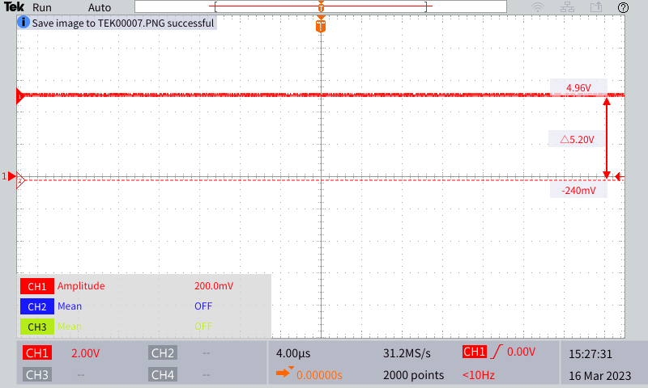
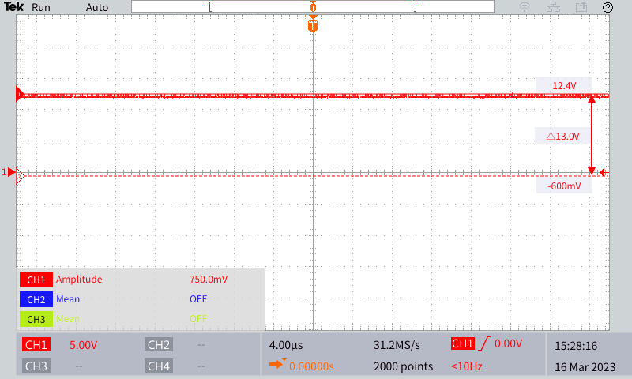
4.96V output
12.4V output

Slide 13
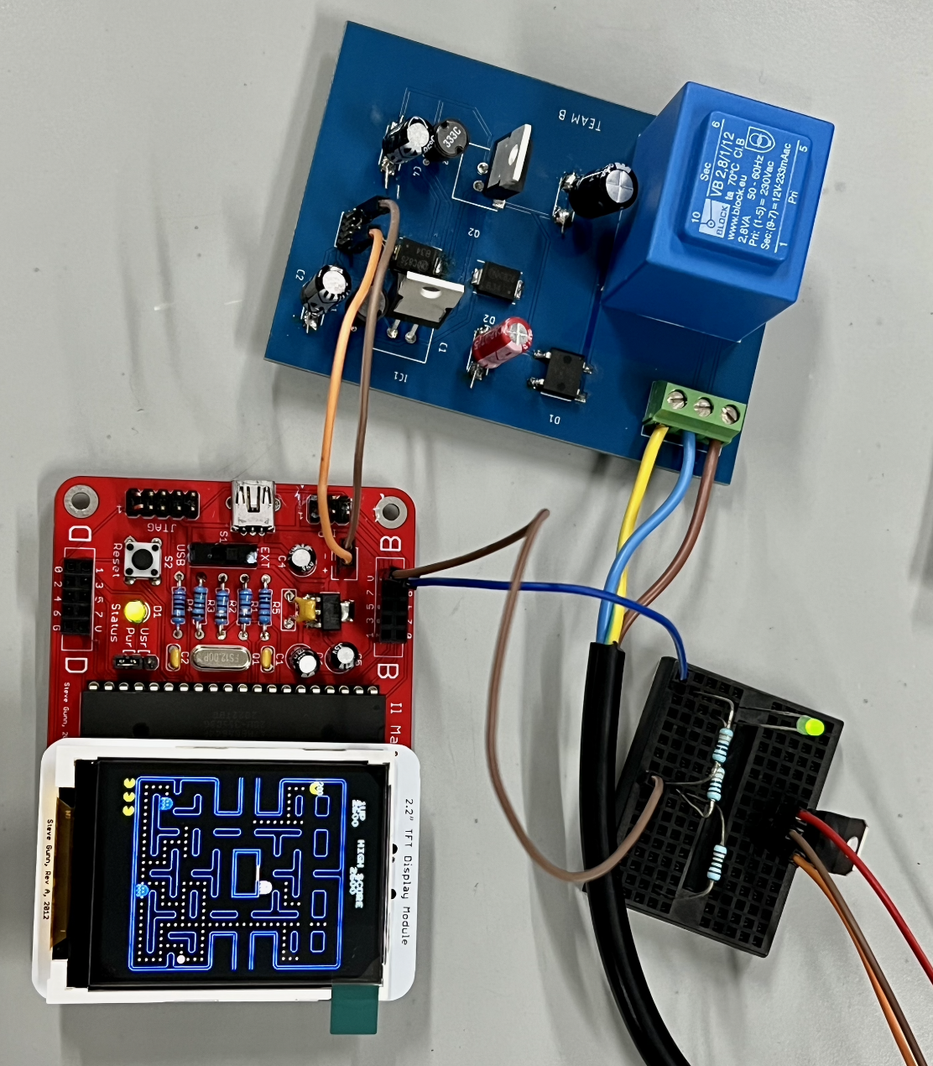
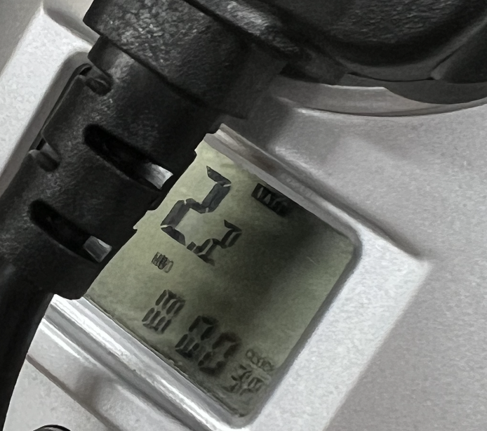
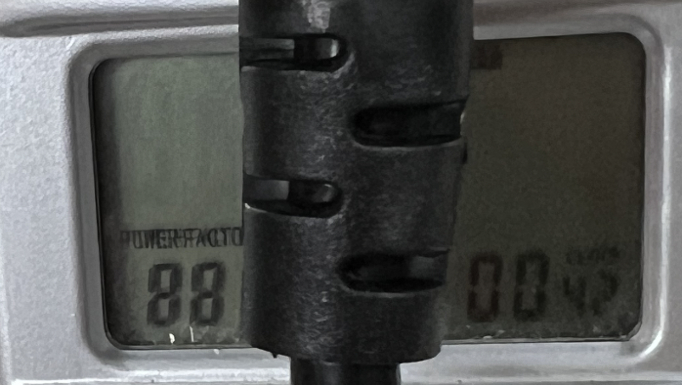
Power Consumption: 2.2W; Power Factor: 88

Slide 14
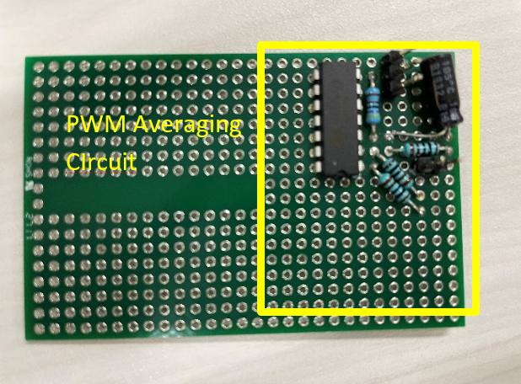
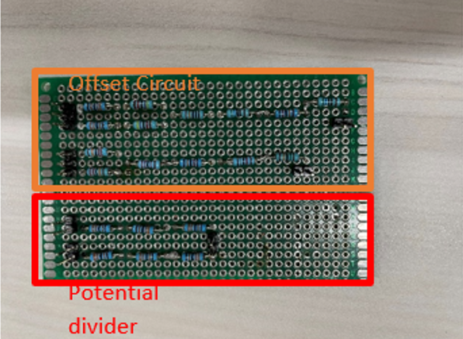
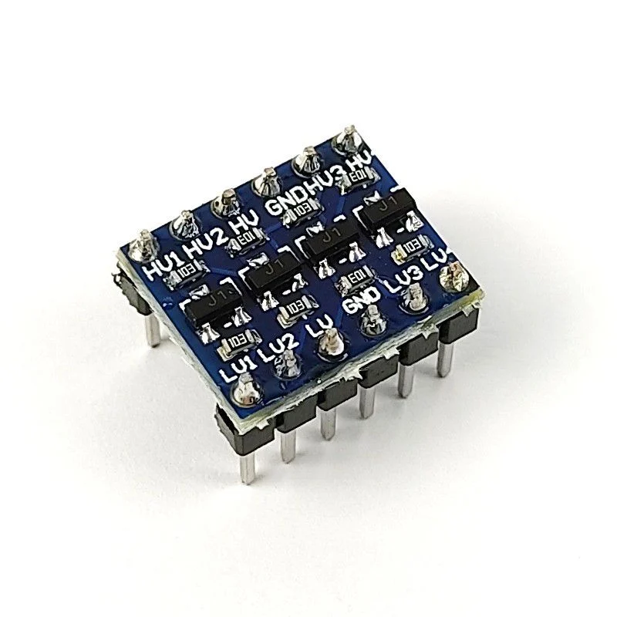
Interface Circuitry
PWM AVERAGE CIRCUIT WITH STEP-UP (COMPLETED)
POTENTIAL DIVIDER (COMPLETED)
OFFSET CIRCUIT (COMPLETED)
LOGIC LEVEL SHIFTER (COMPLETED)

Slide 15
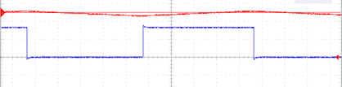
PWM Average Circuit with Step-up
It converts the 3.3V pulse width modulated square wave to a DC voltage ranging from 0 - 10V.
0 to 10V DC
3.3V PWM

Slide 16
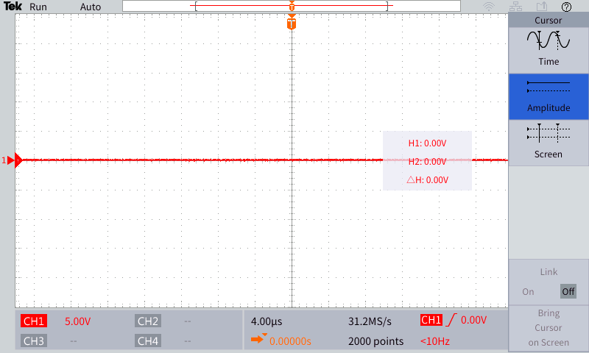
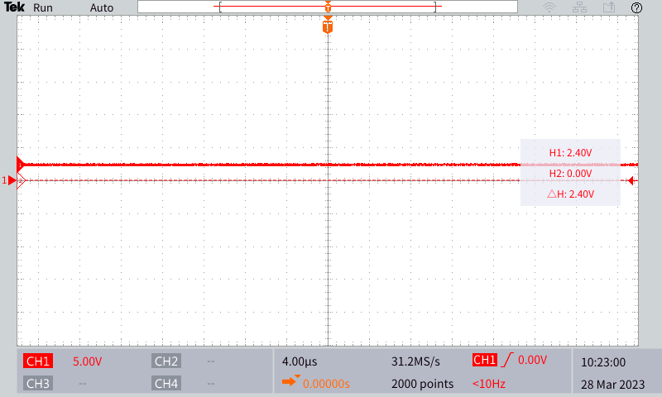
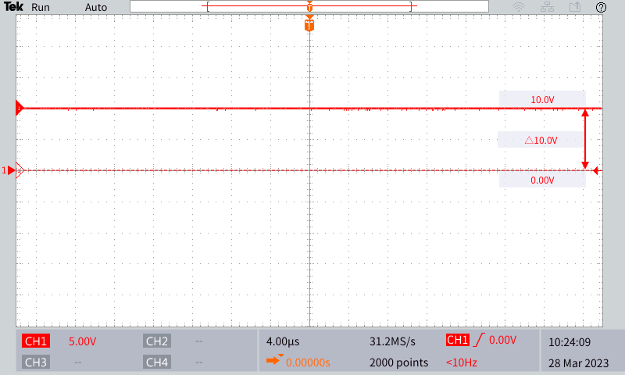
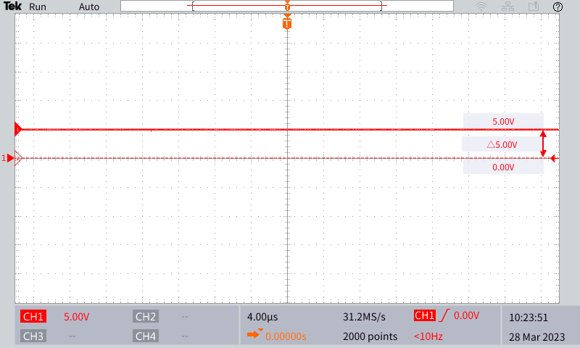
0% Duty Cycle
24% Duty Cycle
100% Duty Cycle
50% Duty Cycle

Slide 17
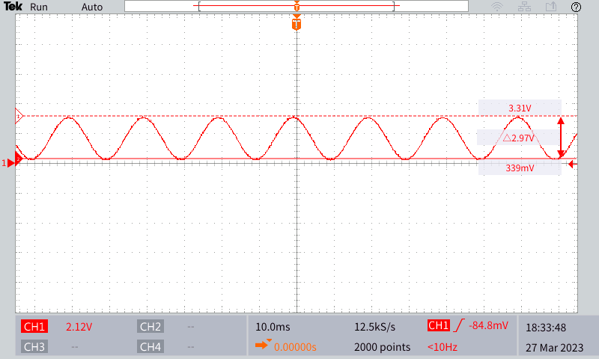
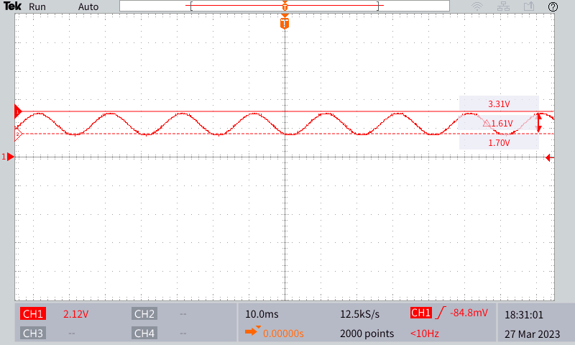
Potential Dividers and Offset Circuits
Potential Dividers and Offset Circuits are implemented to adjust the analogue signals from testbed to fit the input range of Il-Matto’s ADC.
Busbar Current
Busbar Voltage

Slide 18
Logic level shifter
The working of the bidirectional logic level shifter is tested by using the Raspberry Pi’s 5V as HV and the Il Matto’s 3.3V as LV.
It is verified that the logic level shifter is able to shift from 3.3V to 5V and vice versa.

Slide 19
GUI
Motivation
Reduce the number of parameters shown on the main screen
Add more figures and images to the main screen

Slide 20
GUI
Data that needs to be displayed
Busbar voltage
Busbar current
Total power consumption by loads at every hour
Green energy power output at every hour
Which loads are demanding power and are being supplied power
Charge in the battery and the battery status (charging, discharging or idle)

Slide 21


Busbar Voltage and Current
The voltage and current data is displayed as numbers but an icon was added to both parameters to make it more aesthetic.
p.s. Please note that these are arbitrary values chosen to show how the display looks like. These aren’t real values.

Slide 22


Power Consumption and Green Energy Output
Similar to busbar voltage and current, we made use of icons to improve the aesthetics of the display.
p.s. Please note that these are arbitrary values chosen to show how the display looks like. These aren’t real values.

Slide 23


Loads and Battery
The loads are represented as squares. Each square is coloured white if it doesn’t demand any power, blue if it demands power and is being supplied power and red if it demands power but doesn’t get power.
The battery colour depends upon its status (blue for idle, red for discharge and green for charging) and the level of the battery depends upon charge.
The pictures below shows Load 1 and 3 are being supplied and battery charge is full but idle.

Slide 24
Algorithm
Simple
Cost
Priority
Simple: Effective power saving and usage by the storage supply
Cost: Reduces the overall cost by choosing different supply and load combos
Priority: Use valid load and source combos based on a predefined priority list

Slide 25
Algorithm
Simple Algorithm:
Find total demand from loads
Find the total natural resource current
Decide if storage should charge,discharge or remain idle
Calculate the total available current
If available current is less than demand, set mains
L1
Charge: N-D ≥ 1A
Discharge: D-N ≤ 1A
Idle: Neither of the above
L2
Demand =
L1+L2+L3
WT
Natural =
WT+PV
N
Available = N+S
A
Mains = D-A
L3
PV
S
D
(1)
(2)
(3)
(4)
(5)

Slide 26
Algorithm
Simple Algorithm:
Find total demand from loads
Find the total natural resource current
Decide if storage should charge,discharge or remain idle
Calculate the total available current
If available current is less than demand, set mains
Algorithm Functions
calc_R() // Calculate load demand aka. requirement
calc_N() // Calculate natural resources
set_storage() // Set situations the storage will charge,discharge,idle
calc_available() // Calculate total available current
set_mains() // Set the mains inputs

Slide 27
Algorithm
Cost Algorithm:
Find the total load demand depending on any combination of loads
Find the total costs/earnings associated with each load combo
Cycle through supply combinations for each load combination, check validity
Cycle through the valid combinations and find the settings for the lowest cost
$A
$B
$C
$D
$E
L1
L1
A
Valid = A≥D
Invalid = A<D
Find lowest cost
L2
Demand =
L1+L2+L3
L2
Cost =
$L1+$L2+$L3
Valid
L3
D
L3
(1)
(2)
(3)
(4)

Slide 28
Algorithm
Cost Algorithm:
Find the total load demand depending on any combination of loads
Find the total costs/earnings associated with each load combo
Cycle through supply combinations for each load combination, check validity
Cycle through the valid combinations and find the settings for the lowest cost
Algorithm Functions
load_require() // Finds total requirement for any load combination
load_cost() // Finds the total cost for any load combination
validity_costs() // Calculates validity and cost of each load and supply combination
optimum_combo() // Finds the valid, lowest cost load and supply settings
implement_settings() // Implements everything

Slide 29
Algorithm
Priority Algorithm:
Find the maximum supply current based on priority
Find the total prioritised loads that can be supplied to by the sources
WT
L1
PV
Available = WT+PV+S
L2
Load =
L1+L2+L3
S
L3
(1)
(2)
Algorithm Functions
priority_supply() // Calculate the maximum possible current for the prioritised supplies
priority_load() // Calculates the total possible demand in the order of the prioritised loads
implement_settings() // Sets every signal that needs to be set

Slide 30
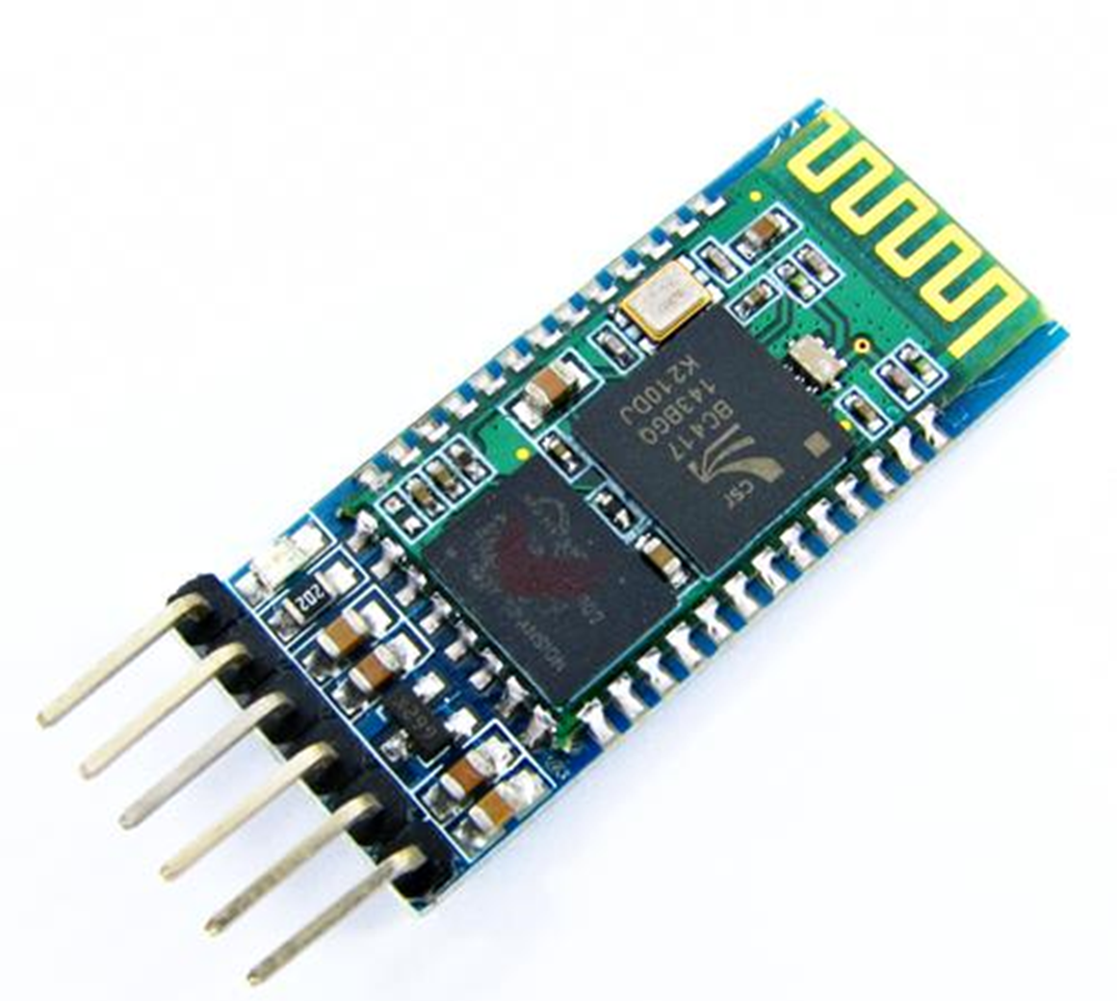
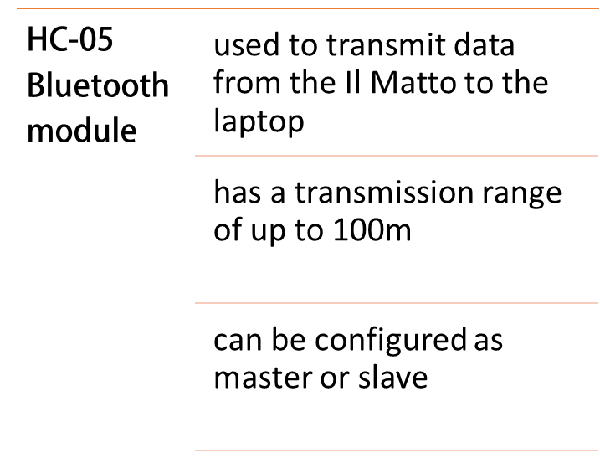

Slide 31
Web application
Built using Python programming language. The libraries used are as following
Libraries | Usage
Streamlit | A web framework that enables web application to be built easily
Pyserial | For serial communication between the Bluetooth module and laptop
Threading | For multithreading purpose. Multithreading is needed to prevent the application from being unresponsive while the incoming data is being read.
Pillow | For image processing purpose

Slide 32
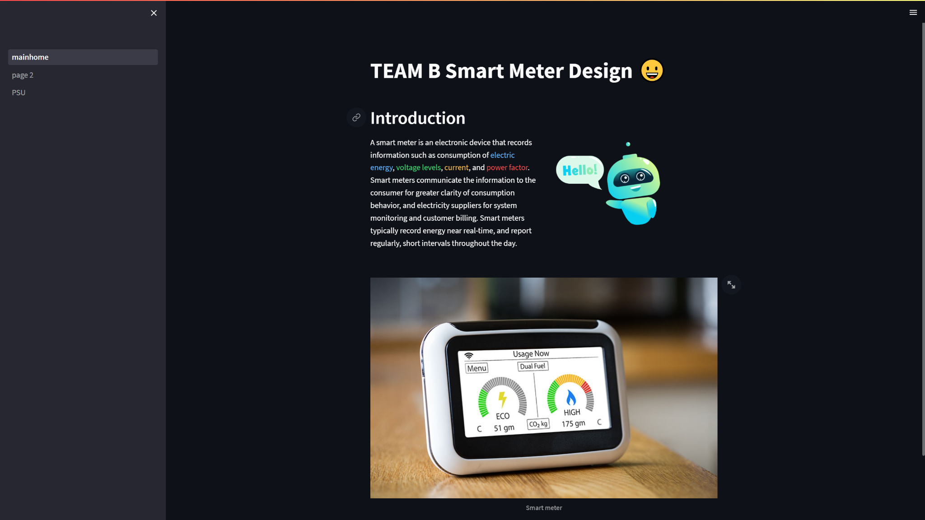
Web Application Homepage

Slide 33
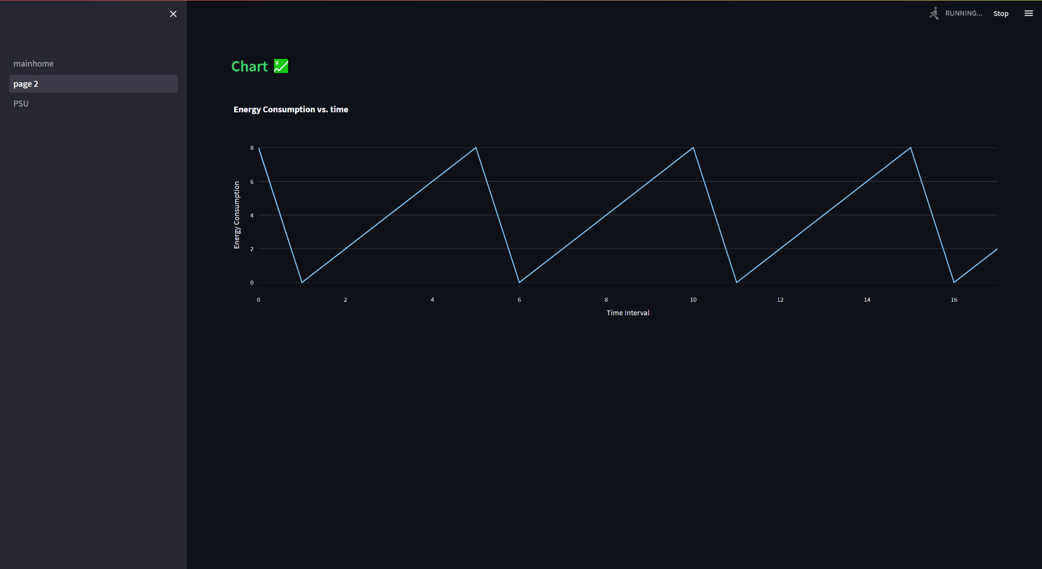
Web Application Chart Display

Slide 34
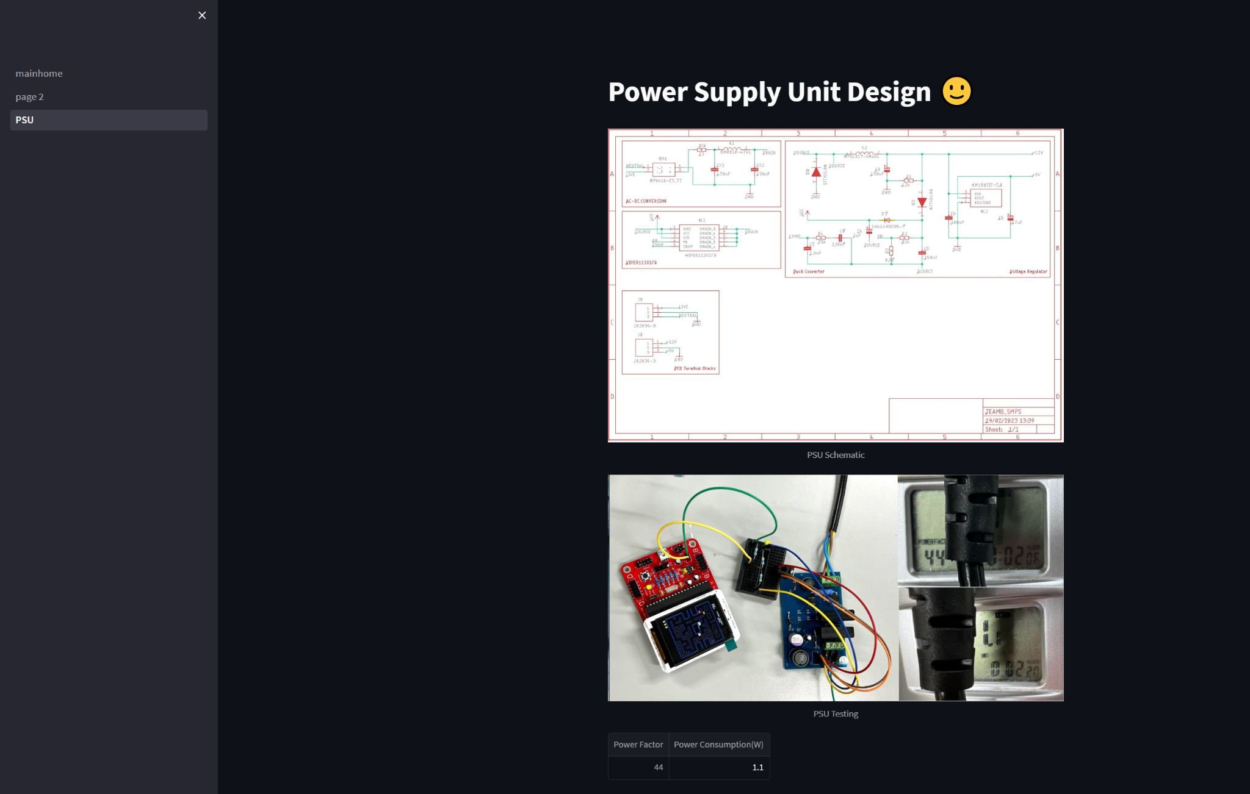
Web application

Slide 35
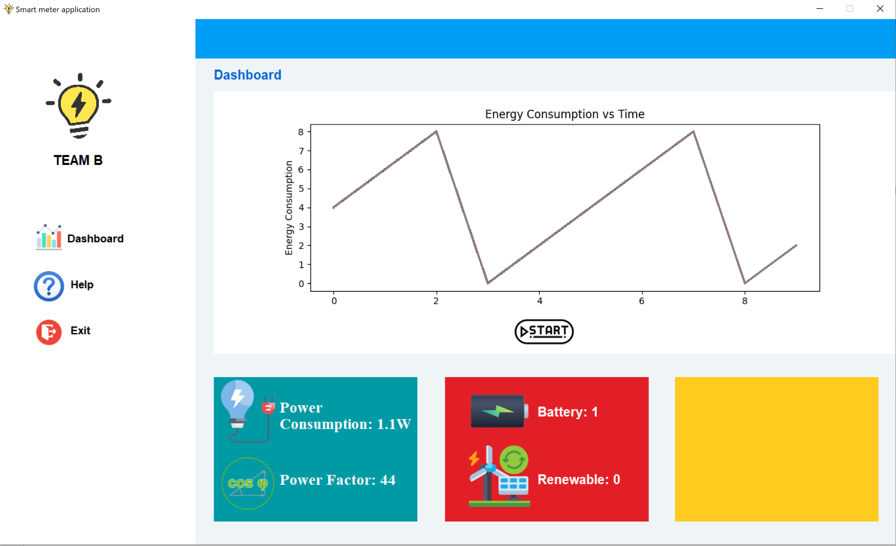
Desktop application

Slide 36
End of Presentation

